Slide 1
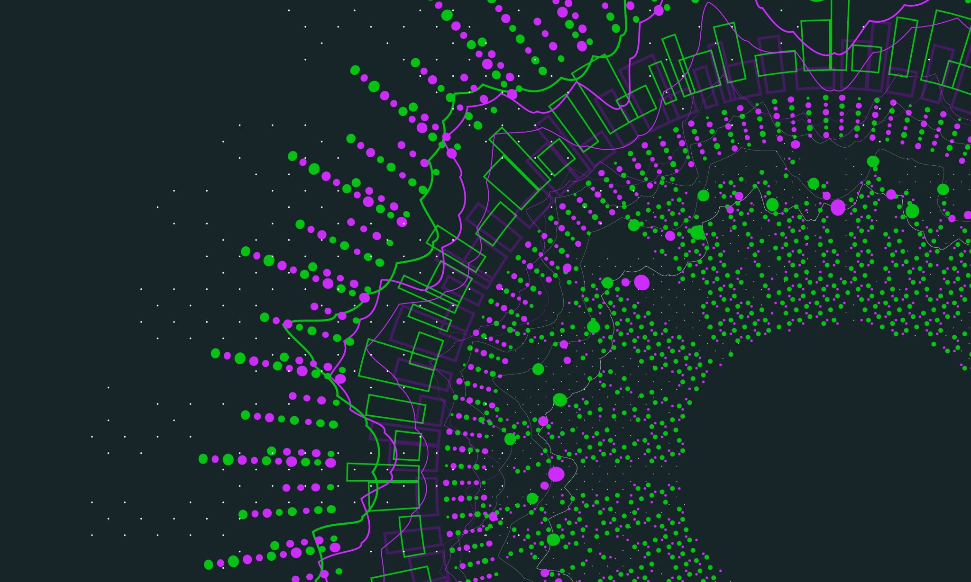
MDA 530: Midterm Analyzing dataset Kate Jorjoliani

Slide 2

Student Mental Health

Slide 3
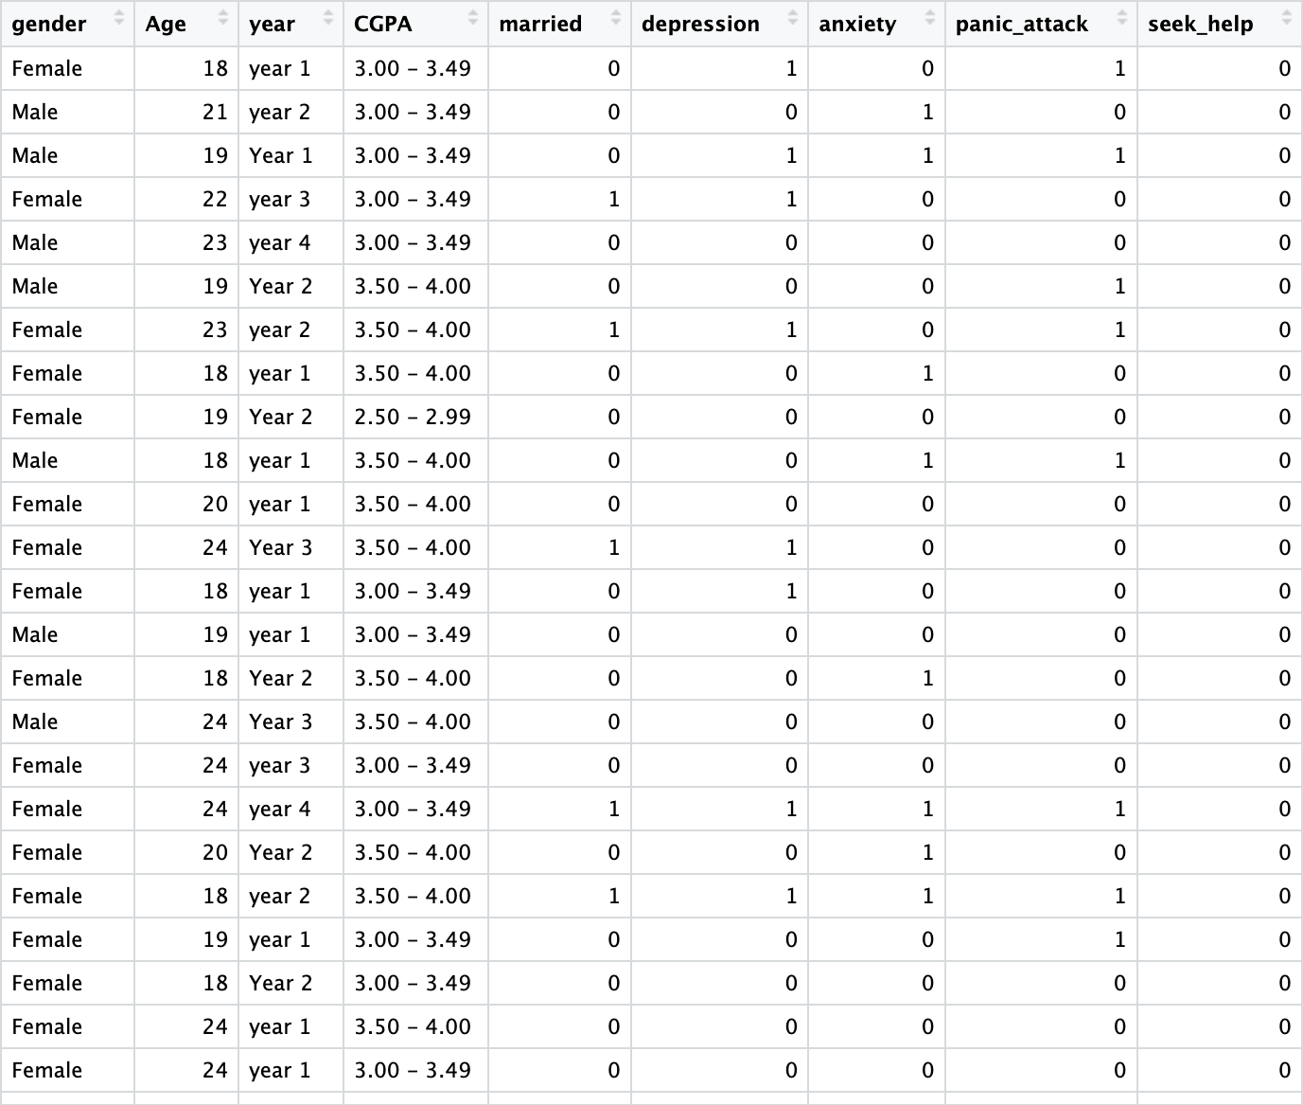
Notes:
Binary Classification dataset

Slide 4
Data Analysis
Data preparation/preprocessing
Exploratory data analysis (EDA)
Model building
Evaluation/Interpretation

Slide 5
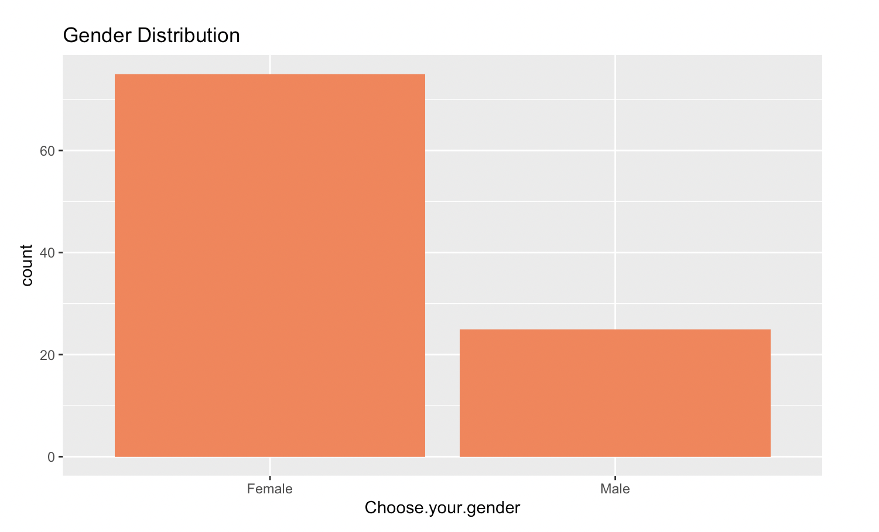
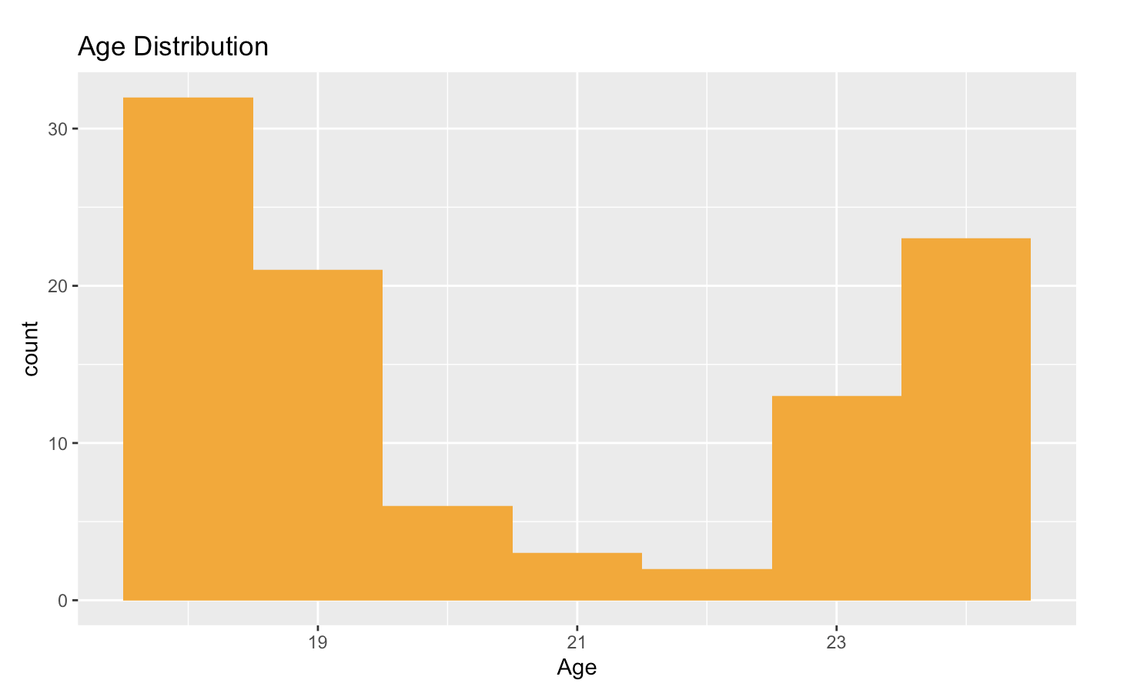
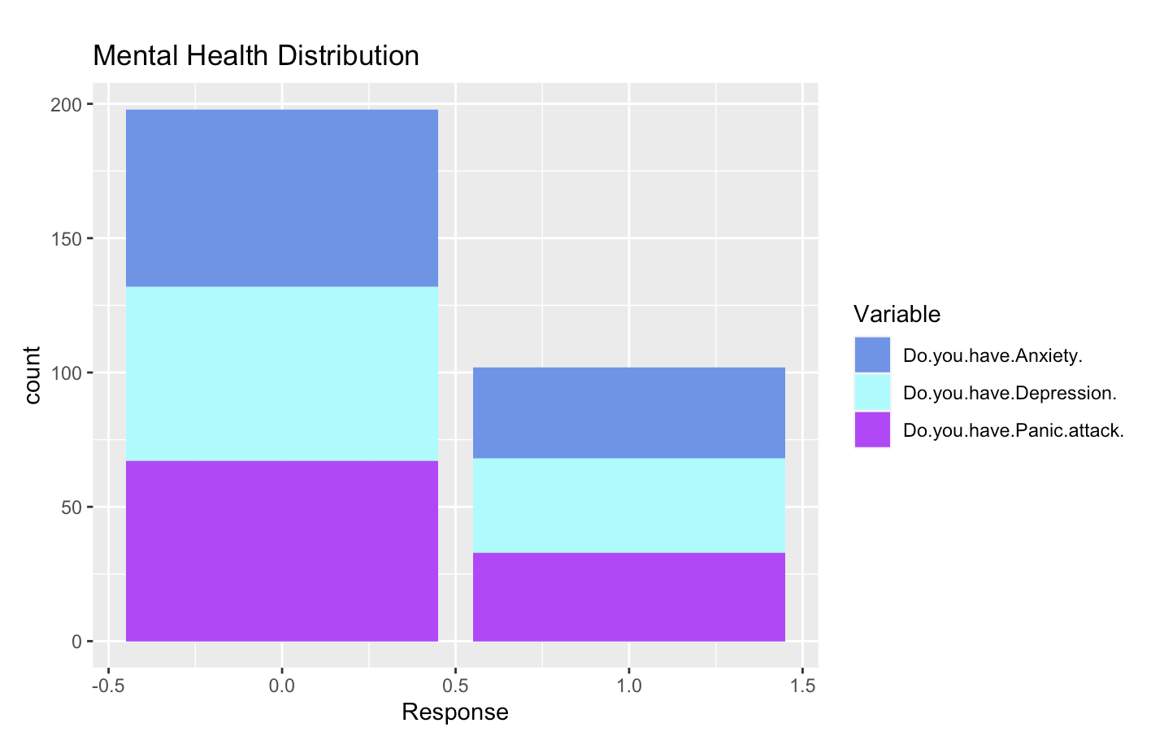
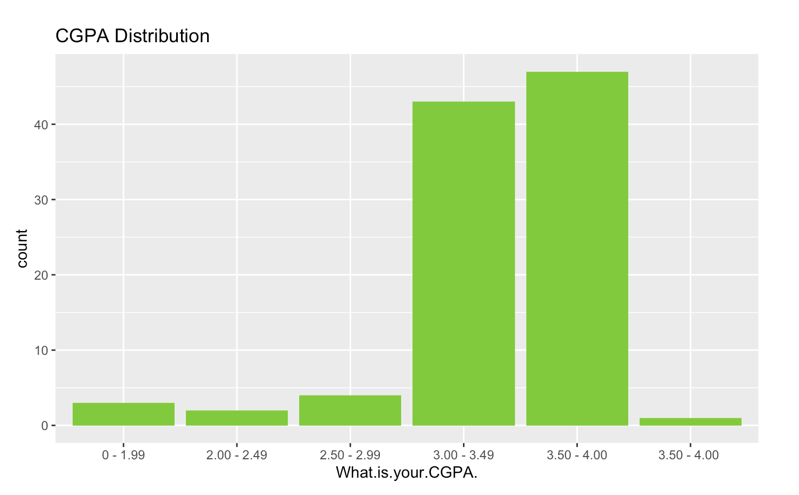
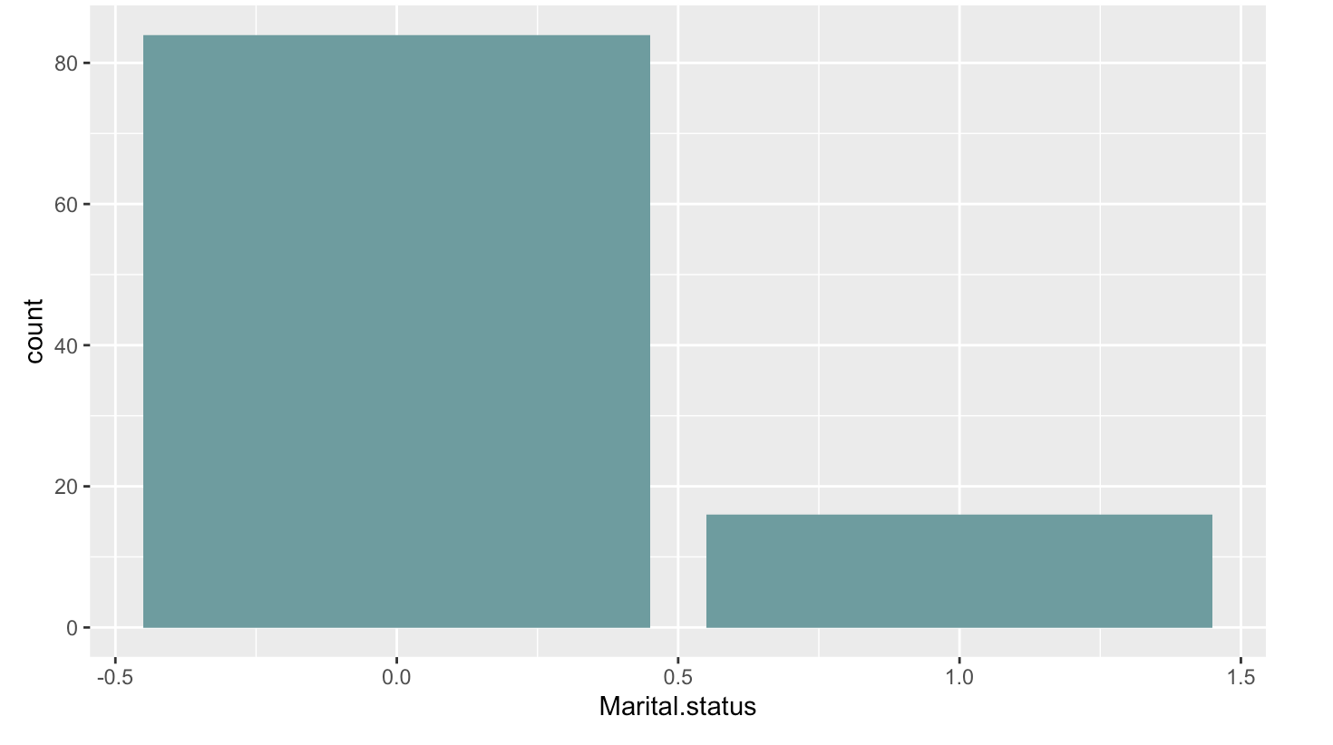
Exploratory Data Analysis: Data Summary
Marital Status

Slide 6
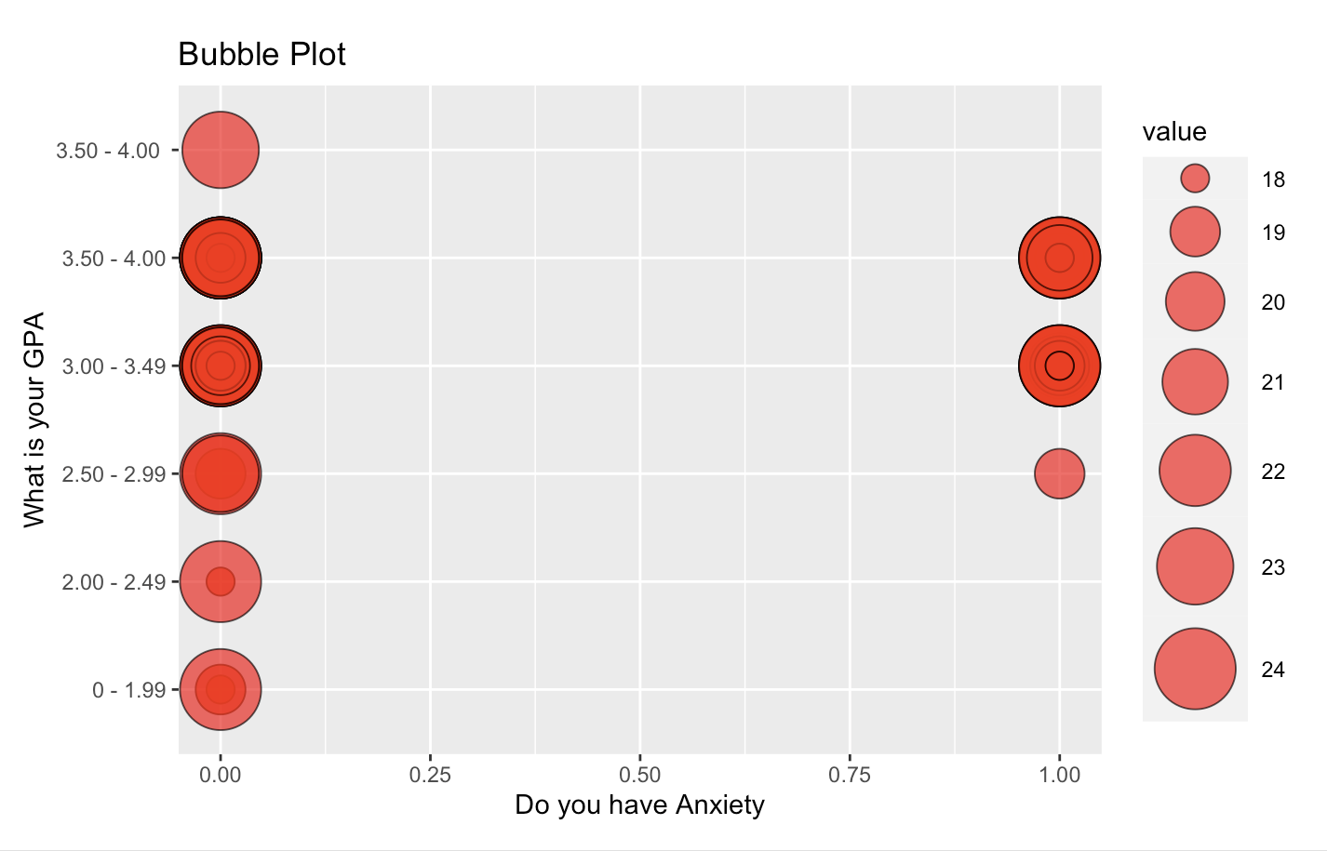
Visualizations: Bubble Plots
Age
Most students reported not having anxiety.
Most reports were between GPAs 3.00-4.00
Notes:
Smaller bubbles – lower values, bigger bubbles – higher values. Darker bubbles - higher density(more answers), lighter bubbles – lower density.

Slide 7
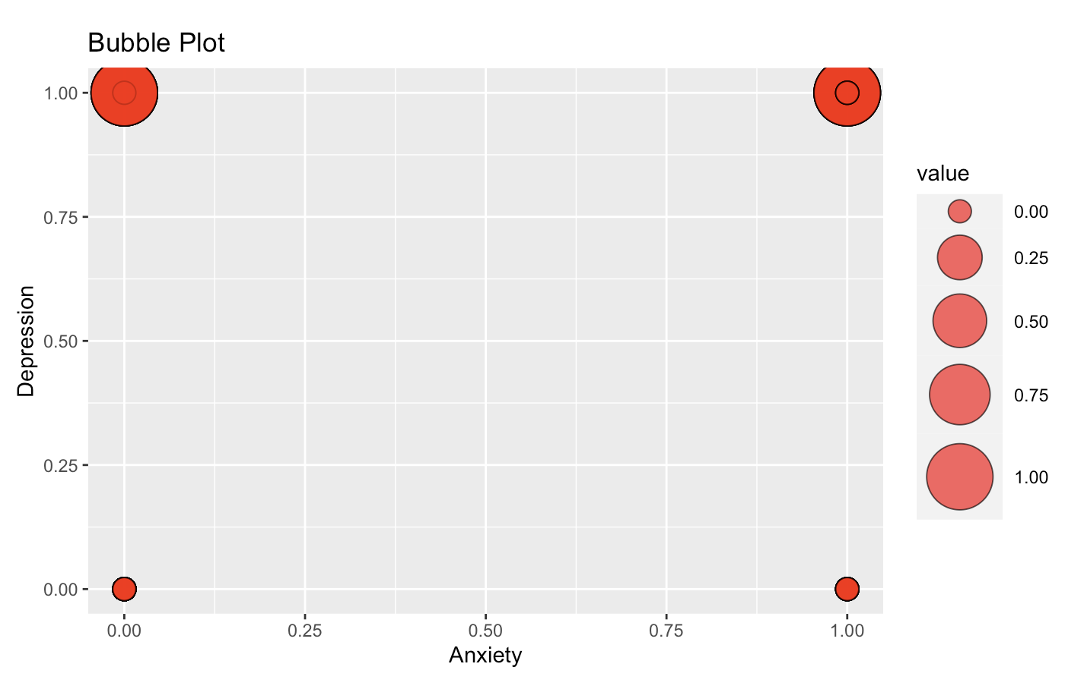
Marital Status
More people who are married reported having depression

Slide 8
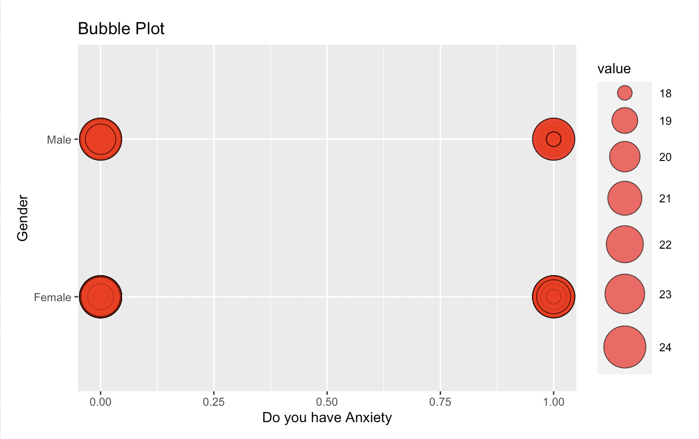
Age
Females had more reports
More reports around age 23

Slide 9
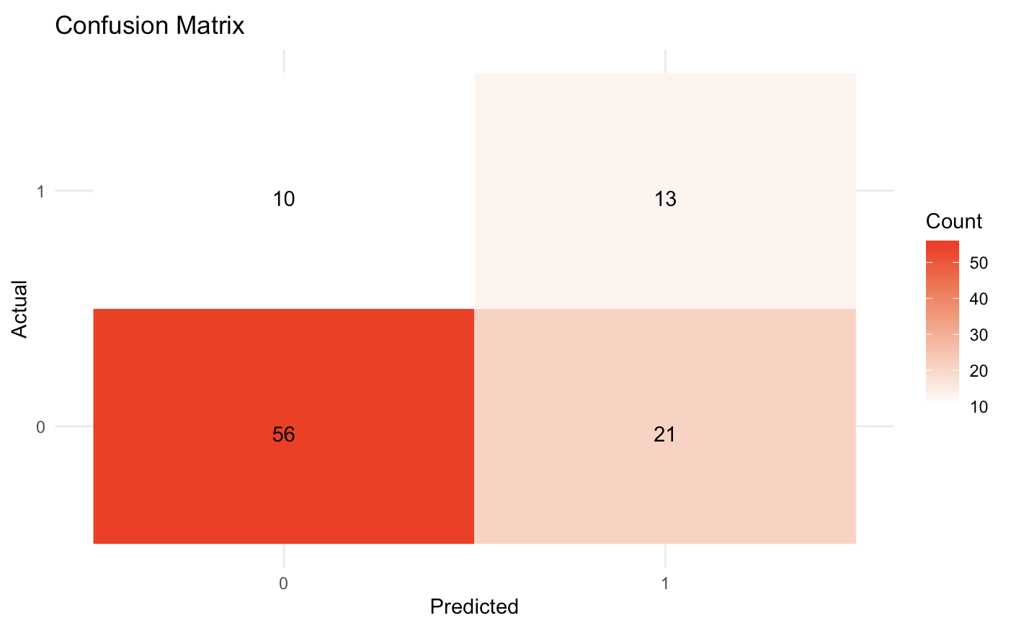
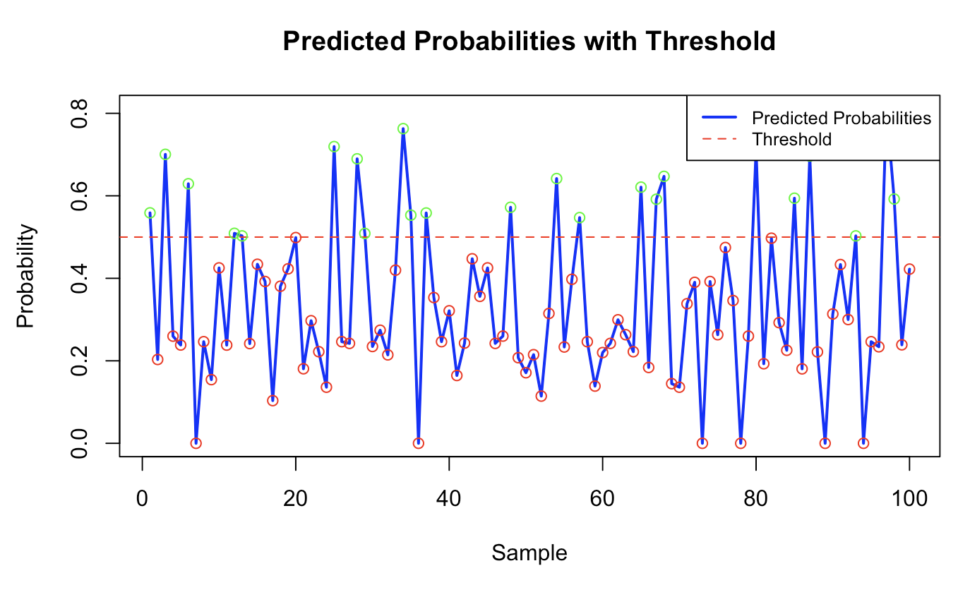
Model building: Logistic Classification
Red dots – 0
Green dots – 1
Prediction: No anxiety
Accuracy: 69%
Sensitivity: 0.38
Specificity: 0.84

Slide 10
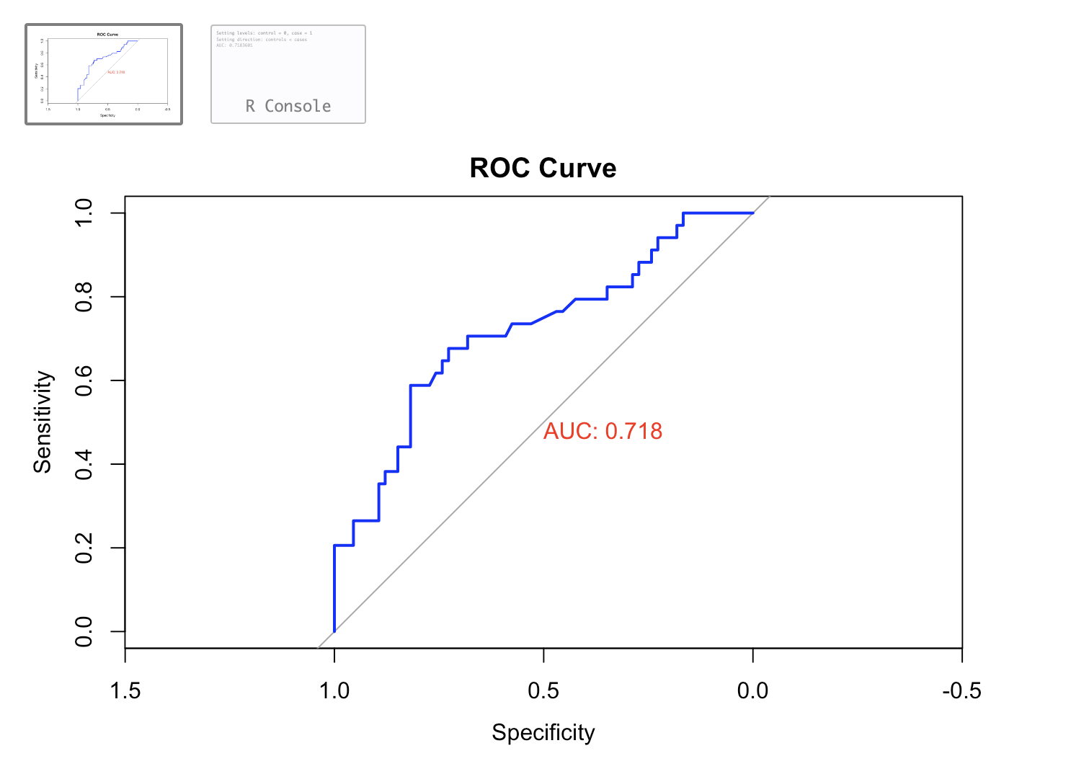
Predicted Probabilities ROC Curve: Evaluate classifier performance
Not the best not the worst.
Notes:
Blue line positioned closer to upper left corner - better accuracy of prediction.

Slide 11
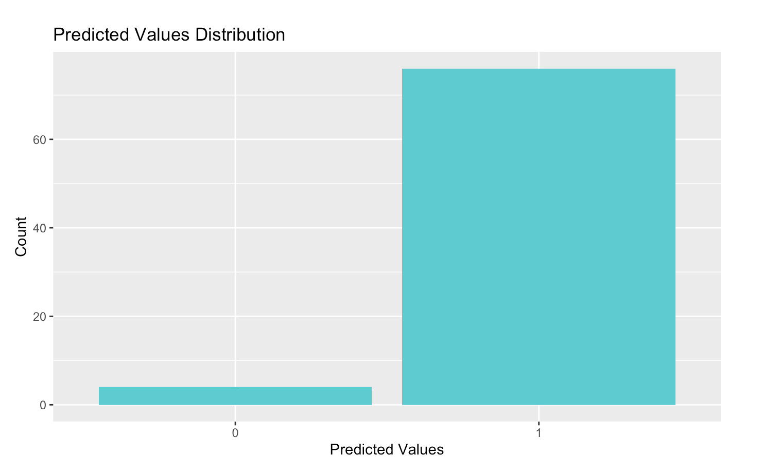
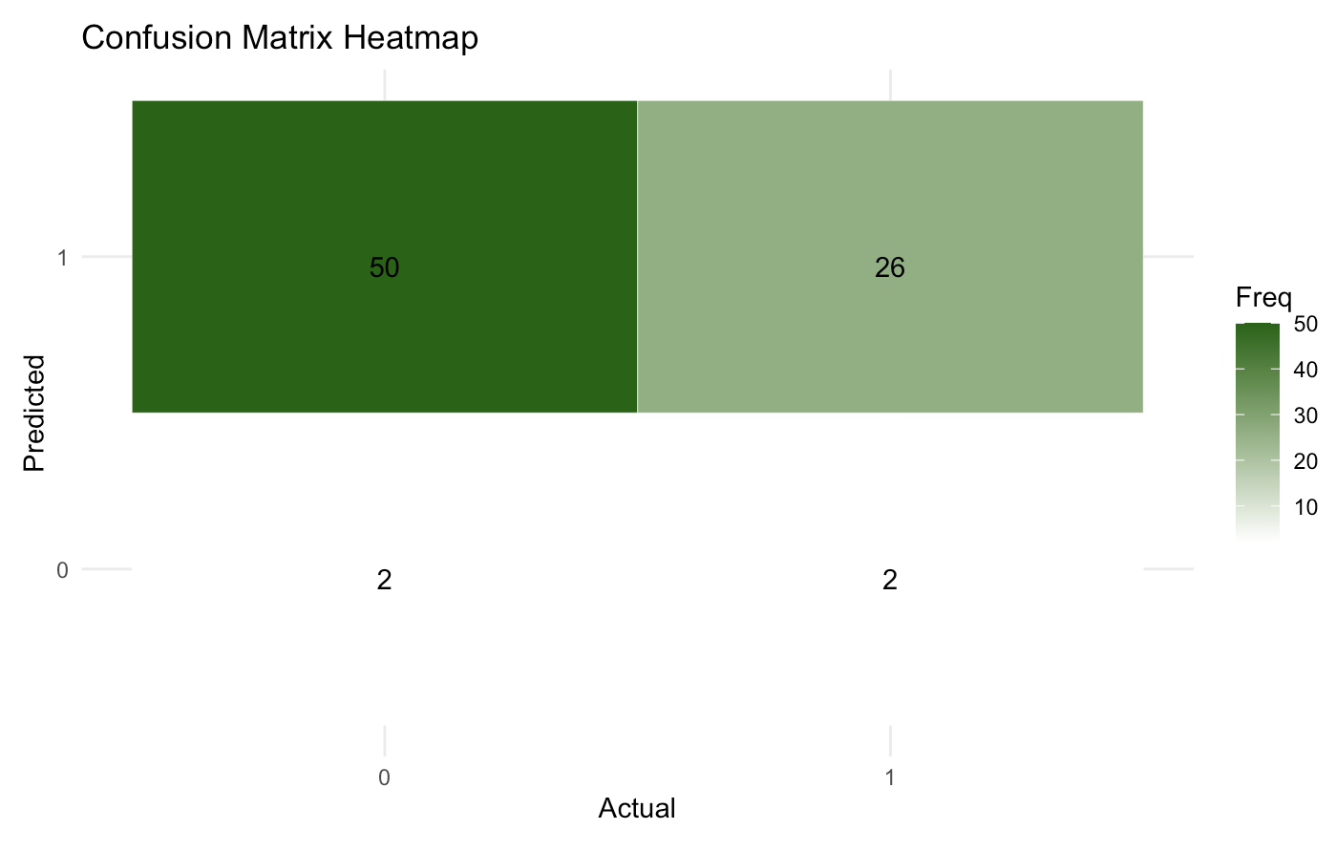
Multinomial Naïve Bayes
Prediction: Yes/Having Anxiety
Accuracy: 35%
Sensitivity: 0.03
Specificity: 0.92

Slide 12
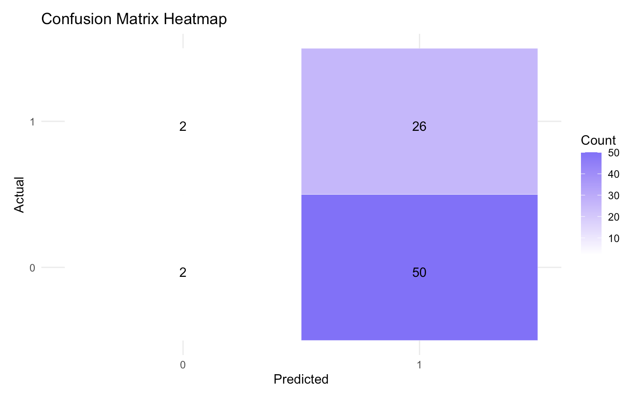
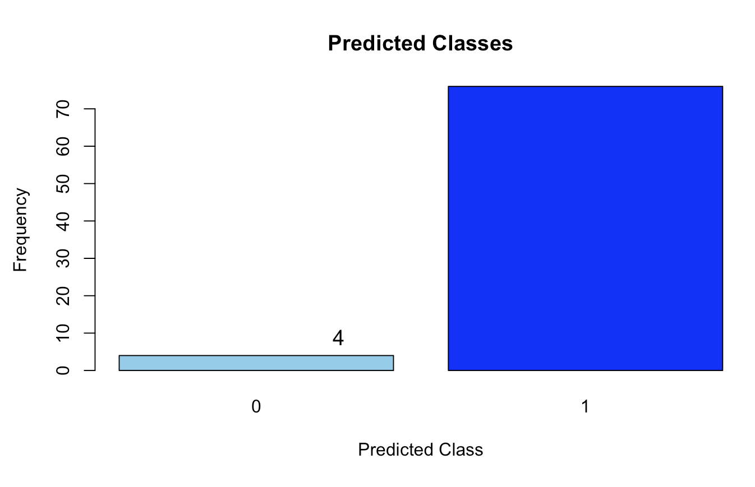
Bernoulli Naïve Bayes
Prediction: Yes/Having Anxiety
Accuracy: 35%
Sensitivity: 0.03
Specificity: 0.92

Slide 13
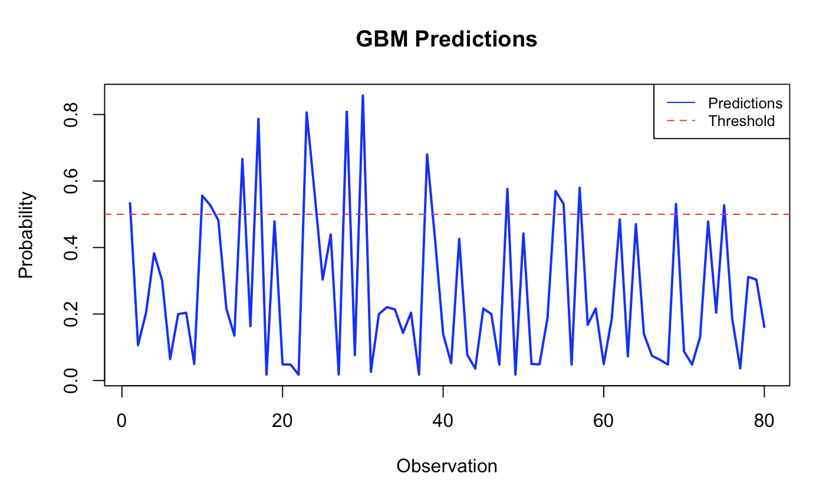
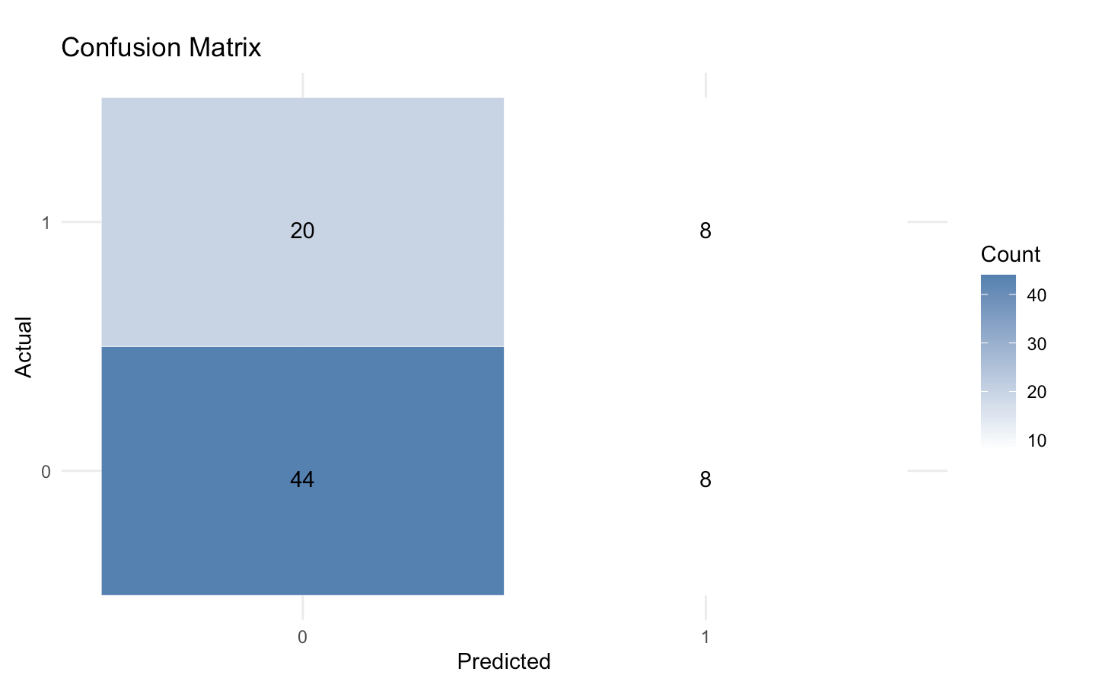
GBM Model
Prediction: No anxiety
Accuracy: 65%
Sensitivity: 0.5
Specificity: 0.68

Slide 14
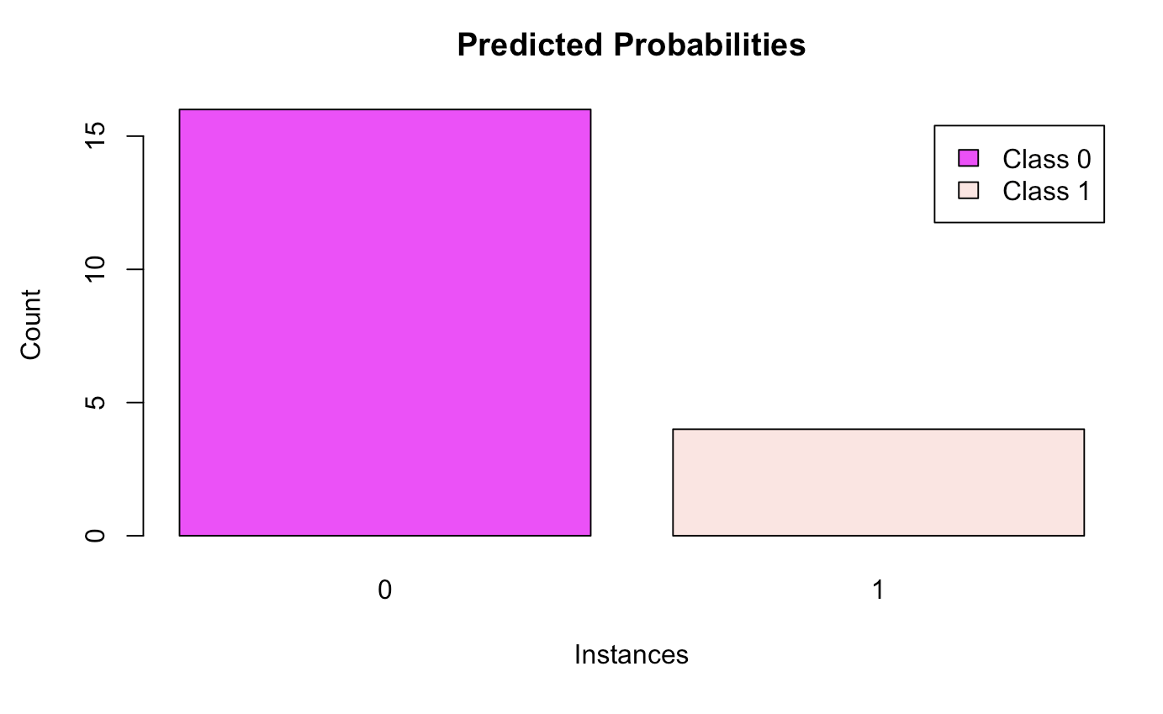
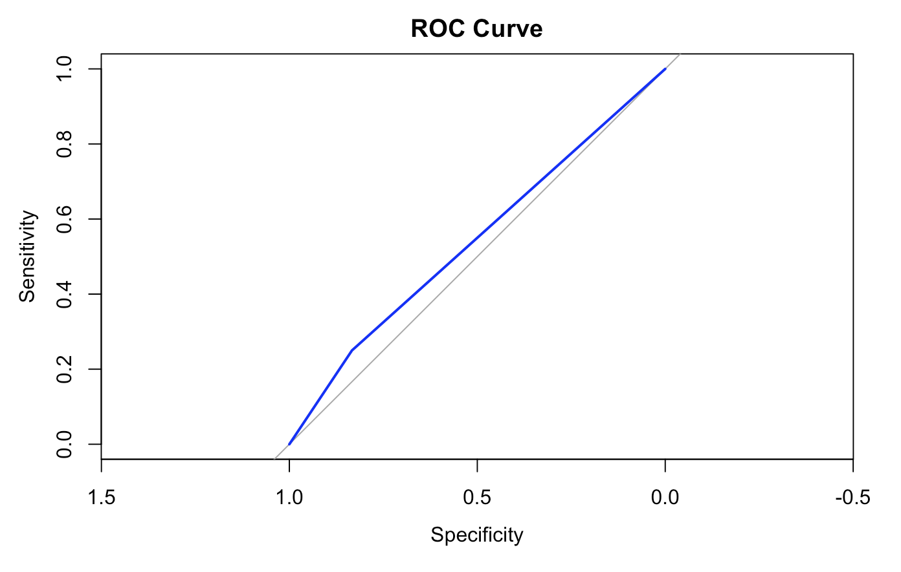
Random Forest Model
Prediction: No anxiety
Accuracy: 60%
Sensitivity: 0.25
Specificity: 0.83
Bad curve

Slide 15
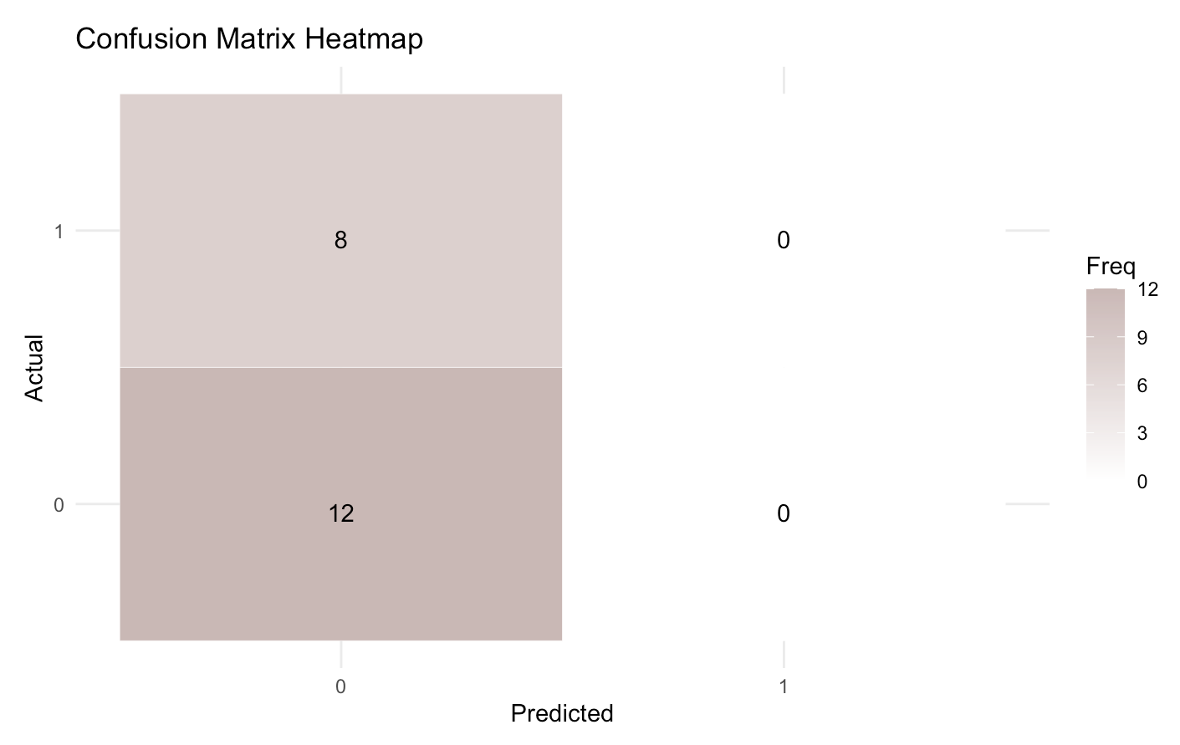
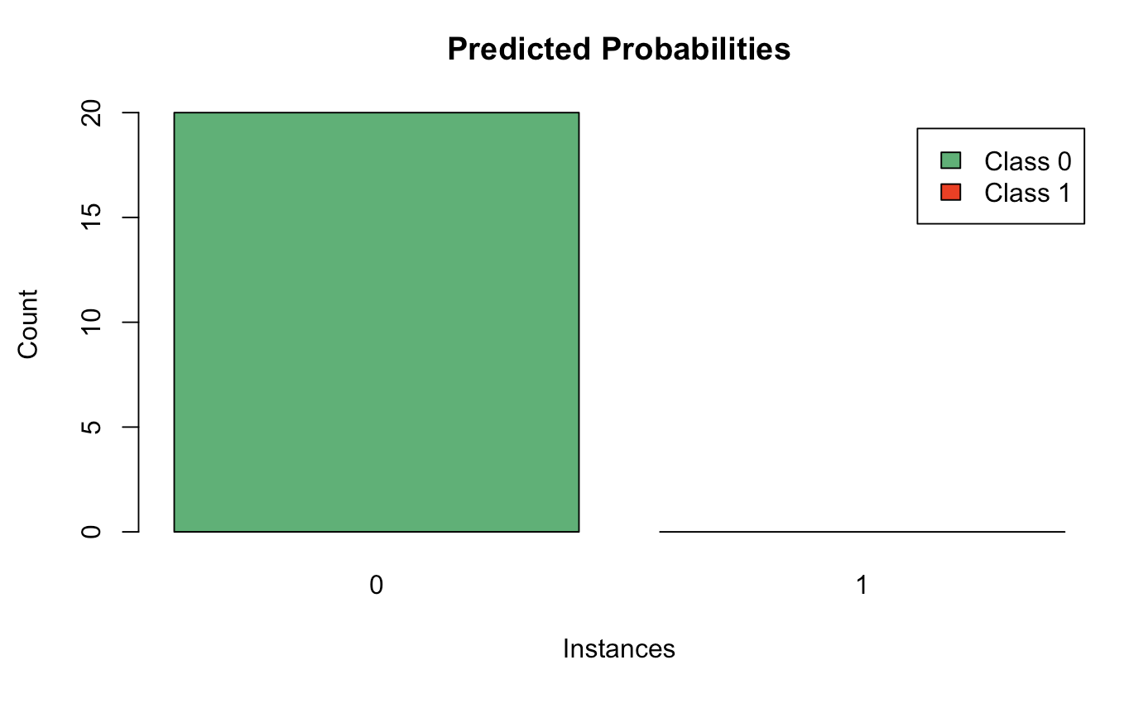
Extra Trees Model
Prediction: No anxiety
Accuracy: 60%
Sensitivity: 0
Specificity: 1

Slide 16
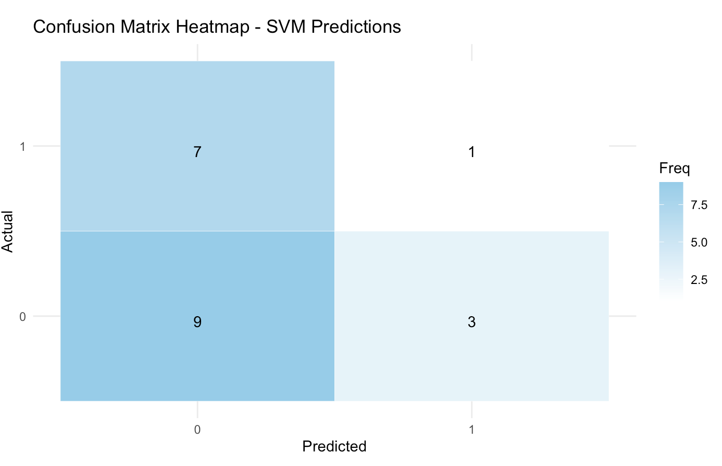
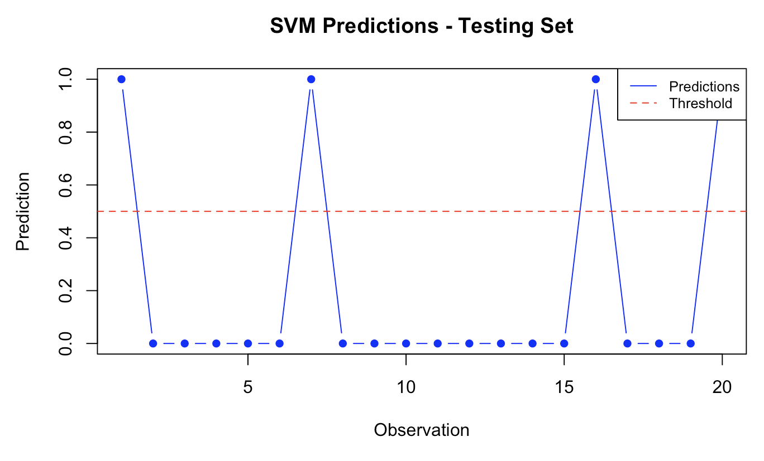
SVM Model
Prediction: No anxiety
Accuracy: 50%
Sensitivity: 0.125
Specificity: 0.75

Slide 17
Comparing all the models(Predictions)
Logistic Classification
Multinomial Naïve Bayes
Bernoulli Naïve Bayes
GBM
Random Forest
Extra Trees
SVM

Slide 18
Logistic Classification
Accuracy: 69%
Multinomial Naïve Bayes: Accuracy: 35%
Bernoulli Naïve Bayes
Accuracy: 35%
GBM
Accuracy: 65%
Comparing all the models(Accuracy)
Random Forest
Accuracy: 60%
Extra Trees
Accuracy: 60%
SVM Accuracy: 50%

Slide 19
Best Model & Its Results
Logistic Classification
Prediction: No anxiety
Accuracy: 69%
Sensitivity: 38
Specificity: 84
Confirmation of well-being
Allocating recourses
Research and continuous improvement

Slide 20

THANK YOU! ANY QUESTIONS?

